Slide 1
Machine Learning - II
ANN, SVM, BDD, Deep Learning

Slide 2
Neural Network
﻿A neural network consists of a network of connected neurons.
Can be used as
Regression model: input vector mapped to a single numerical value
Classifier: input vector mapped to a categorical value
Density Estimation:
Collection of layers:
Each layer is collection of edges (each edge having a weight) terminating on a set of neurons.
Input of each layer is multiplied by edge weights and summed to compute output of each neuron
This output is passed through activation function to create input for next layer.
Weight matrix size
Number of output neurons
The output range of the logistic function is 0 to 1, and the tanh function is −1 to 1.
Error = Target – actual outcome of ANN
Error used to update weights
If error > 0, decrease (increase) weights that result in positive (negative) output
If error < 0, increase (decrease) weights that result in positive (negative) output

Slide 3
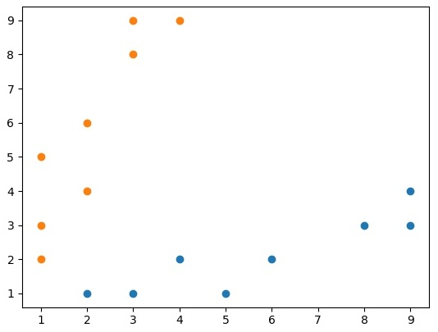
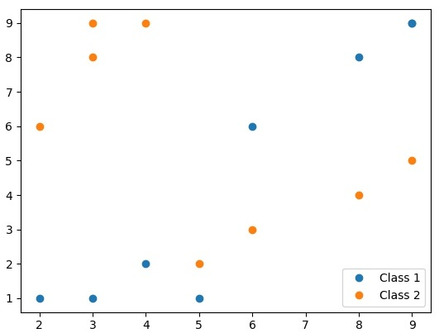

Linear Separability: 2 Class
2D data, a line can separate two classes.
Decision: points above (below) line - class 1 (2)
Linearly Separable Data
Not Linearly Separable Data

Slide 4
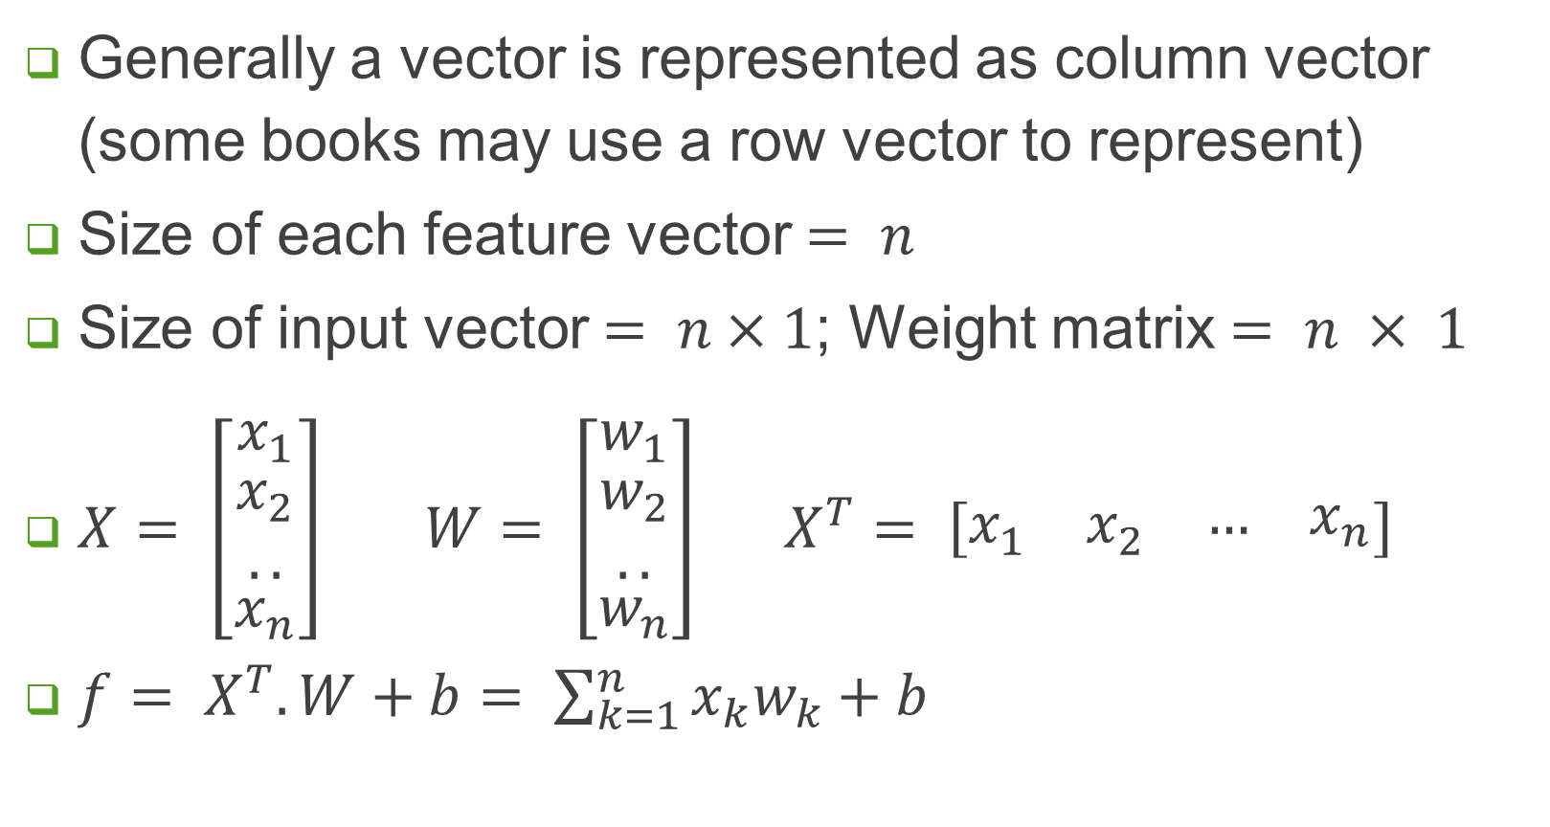
Vector Representation
Generally a vector is represented as column vector (some books may use a row vector to represent)
Size of each feature vector $= n$
Size of input vector $= n×1$; Weight matrix $= n × 1$
$X= \left[\begin{matrix}x_{1} \\ \begin{matrix}x_{2} \\ ..\end{matrix} \\ x_{n}\end{matrix}\right] W= \left[\begin{matrix}w_{1} \\ \begin{matrix}w_{2} \\ ..\end{matrix} \\ w_{n}\end{matrix}\right] X^{T}= \left[\begin{matrix}x_{1} & x_{2} & \begin{matrix}… & x_{n}\end{matrix}\end{matrix}\right]$
$f= X^{T}.W+b= \sum_{k=1}^{n}{x_{k}w_{k}}+b$

Slide 5
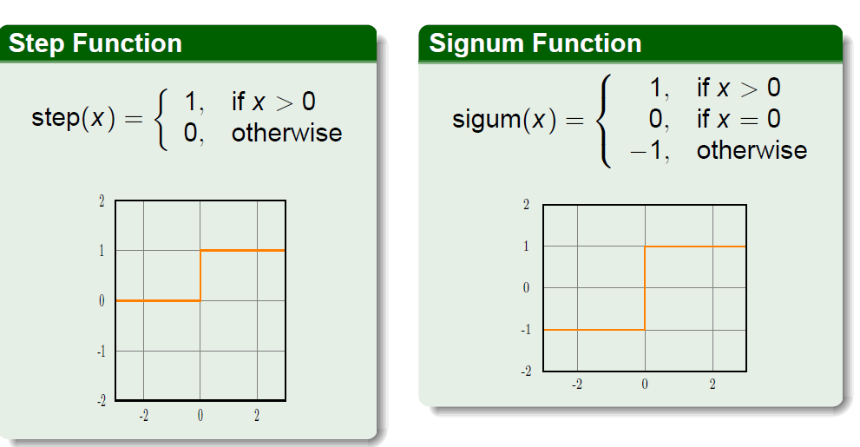
Binary Activation Function

Slide 6
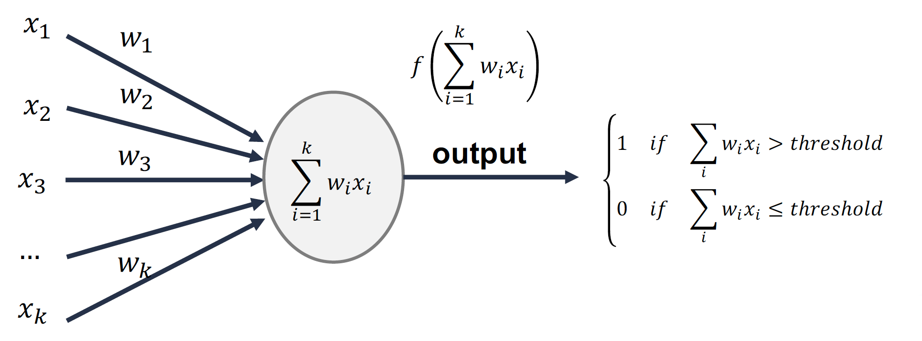


Linear Perceptron
Composed of a single neuron
Limited computing capability.
No learning capability.
Adjustable weights $w1, w2, . . ., wn$, and bias $b$
Scalar product of Input vector and transpose of weight vector
Binary activation ($f$)
If sum > threshold, output is 1 else 0.
+ b
b

Slide 7
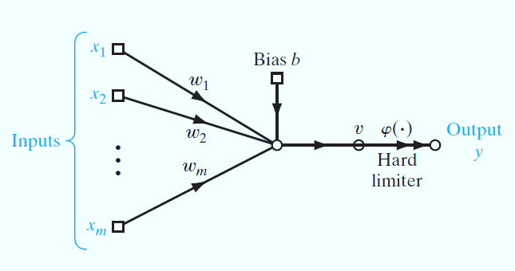

Vector Representation
$X= \left[\begin{matrix}x_{1} \\ \begin{matrix}x_{2} \\ ..\end{matrix} \\ x_{n}\end{matrix}\right] W= \left[\begin{matrix}w_{1} \\ \begin{matrix}w_{2} \\ ..\end{matrix} \\ w_{n}\end{matrix}\right] X^{T}= \left[\begin{matrix}x_{1} & x_{2} & \begin{matrix}… & x_{n}\end{matrix}\end{matrix}\right]$
$f= X^{T}.W+b$
$f= \sum_{k=1}^{n}{x_{k}w_{k}}+b$
Signal Flow Graph of Perceptron

Slide 8
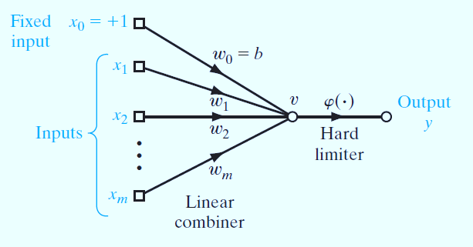
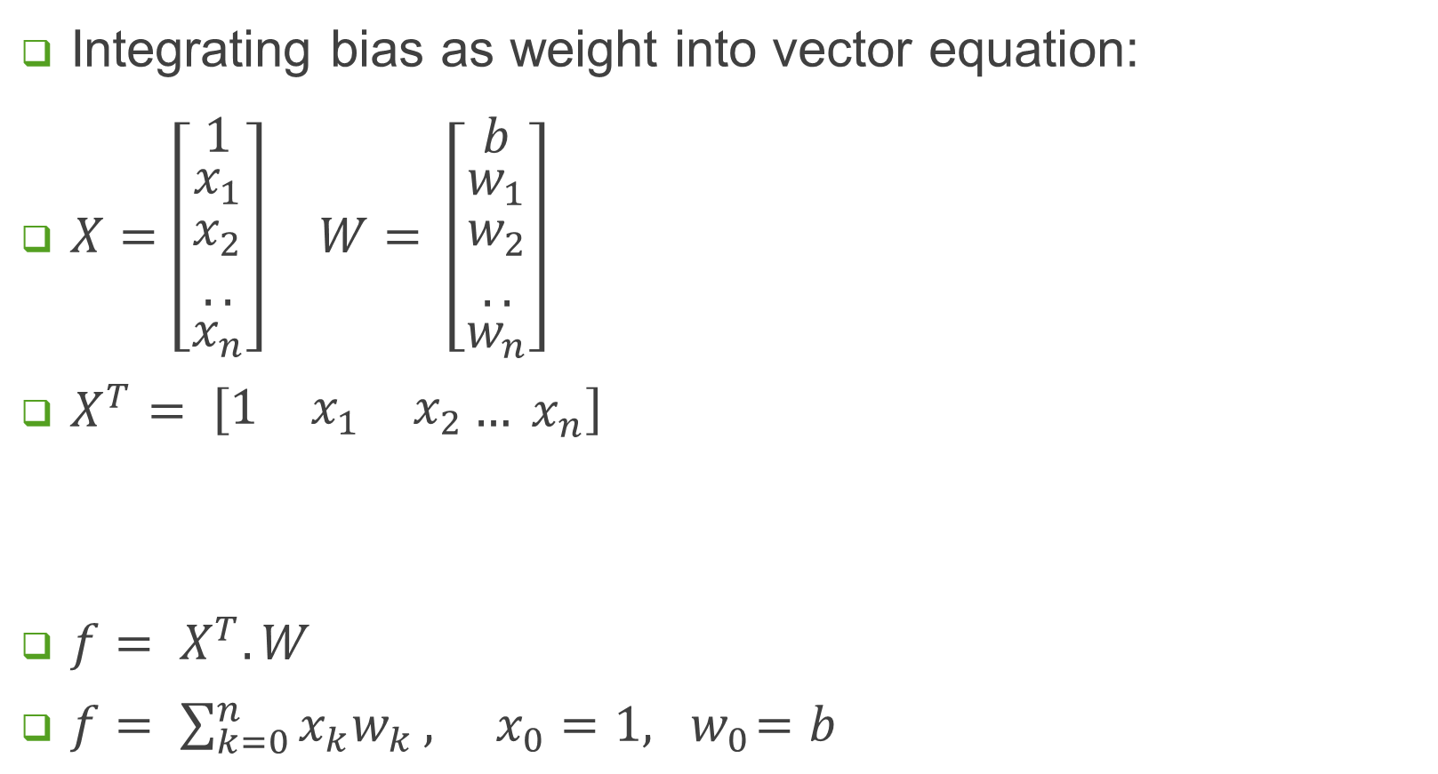
Vector Representation
Integrating bias as weight into vector equation:
$X=\left[\begin{matrix}1 \\ \begin{matrix}x_{1} \\ \begin{matrix}x_{2} \\ ..\end{matrix}\end{matrix} \\ x_{n}\end{matrix}\right] W= \left[\begin{matrix}b \\ \begin{matrix}w_{1} \\ \begin{matrix}w_{2} \\ ..\end{matrix}\end{matrix} \\ w_{n}\end{matrix}\right]$
$X^{T}= \left[\begin{matrix}1 & x_{1} & x_{2}\end{matrix}… x_{n}\right]$
$f= X^{T}.W$
$f= \sum_{k=0}^{n}{x_{k}w_{k}},{ x_{0}=1, w}_{0}=b$
Modified Signal Flow Graph of Perceptron

Slide 9

Linear Perceptron
Linear perceptron: works best when data is linearly separable.
The basic perceptron function is given as:
$f= X^{T}.W+b$
$W$ = weight vector
$b$ = bias
$X$ = input vector
$\sum_{i=0}^{n}{x_{i}^{k}.w_{i}}$
$n$ = number of inputs
$f$ = a hyperplane
Multiple lines may separate the training data. Which one to select?

Slide 10
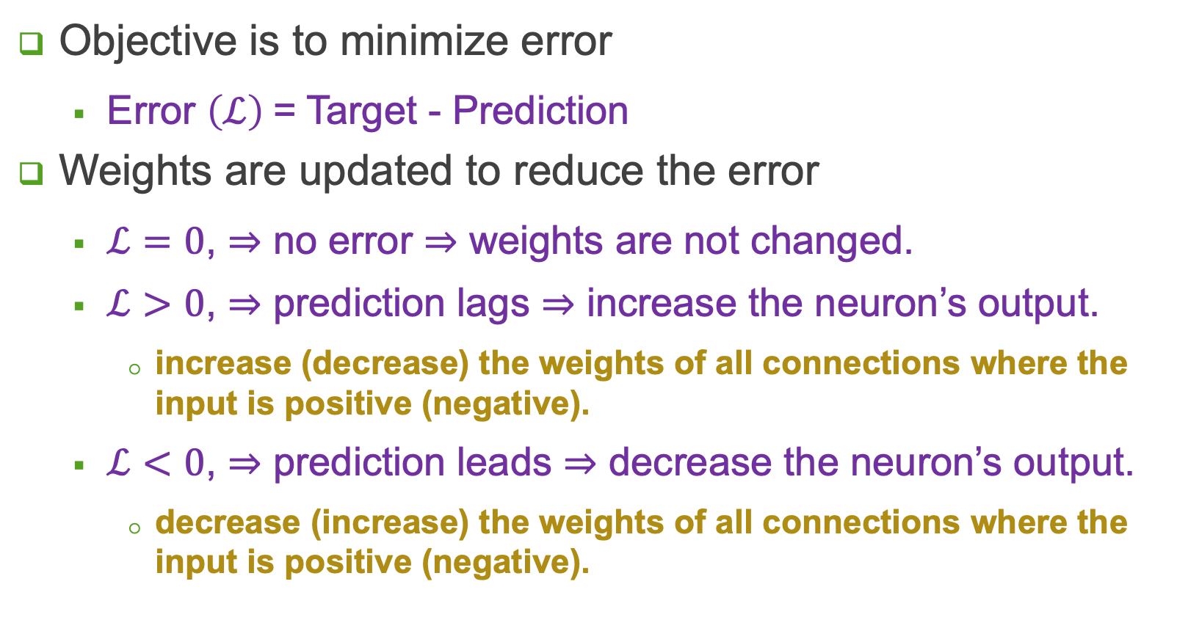
Learning Rule
Objective is to minimize error
Error $\left(ℒ\right)$= Target - Prediction
Weights are updated to reduce the error
$ℒ=0$, $⇒$ no error $⇒$ weights are not changed.
$ℒ>0$, $⇒$ prediction lags $⇒$ increase the neuron’s output.
increase (decrease) the weights of all connections where the input is positive (negative).
$ℒ<0$, $⇒$ prediction leads $⇒$ decrease the neuron’s output.
decrease (increase) the weights of all connections where the input is positive (negative).

Slide 11
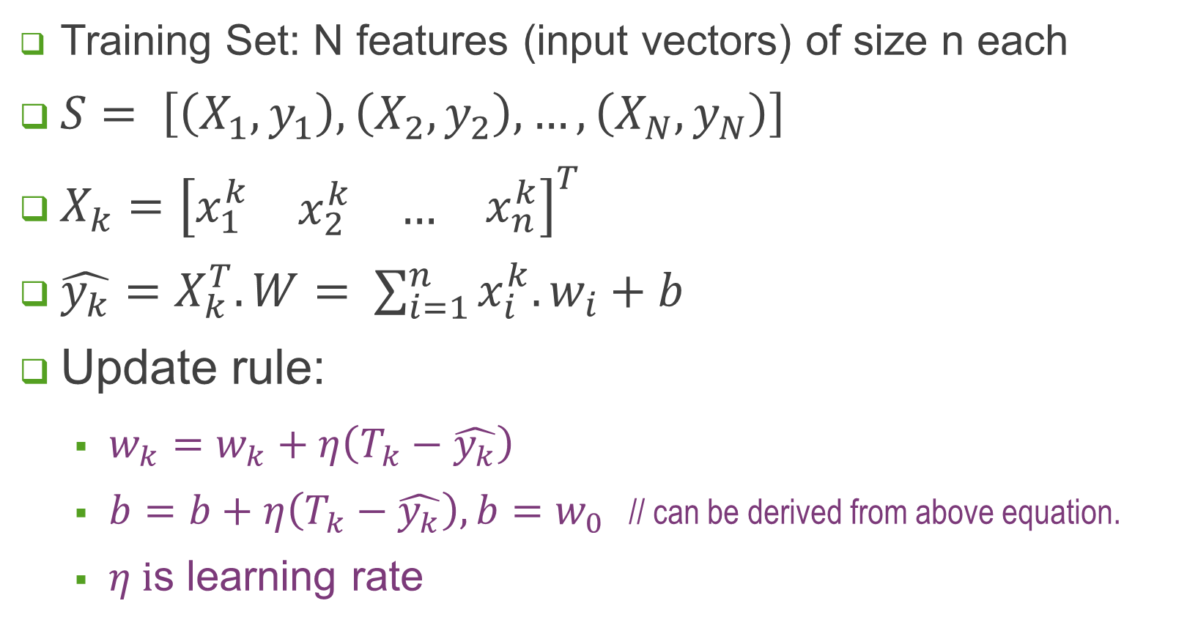
Learning Rule
Training Set: N features (input vectors) of size n each
$S= \left[\left(X_{1},y_{1}\right),\left(X_{2},y_{2}\right),…,\left(X_{N},y_{N}\right)\right]$
$X_{k}={\left[\begin{matrix}x_{1}^{k} & \begin{matrix}x_{2}^{k} & …\end{matrix} & x_{n}^{k}\end{matrix}\right]}^{T}$
$\hat{y_{k}}=X_{k}^{T}.W= \sum_{i=1}^{n}{x_{i}^{k}.w_{i}}+b$
Update rule:
$w_{k}=w_{k}+η\left(T_{k}−\hat{y_{k}}\right)$
$b=b+η\left(T_{k}−\hat{y_{k}}\right), b=w_{0}$ // can be derived from above equation.
$η i$s learning rate

Slide 12
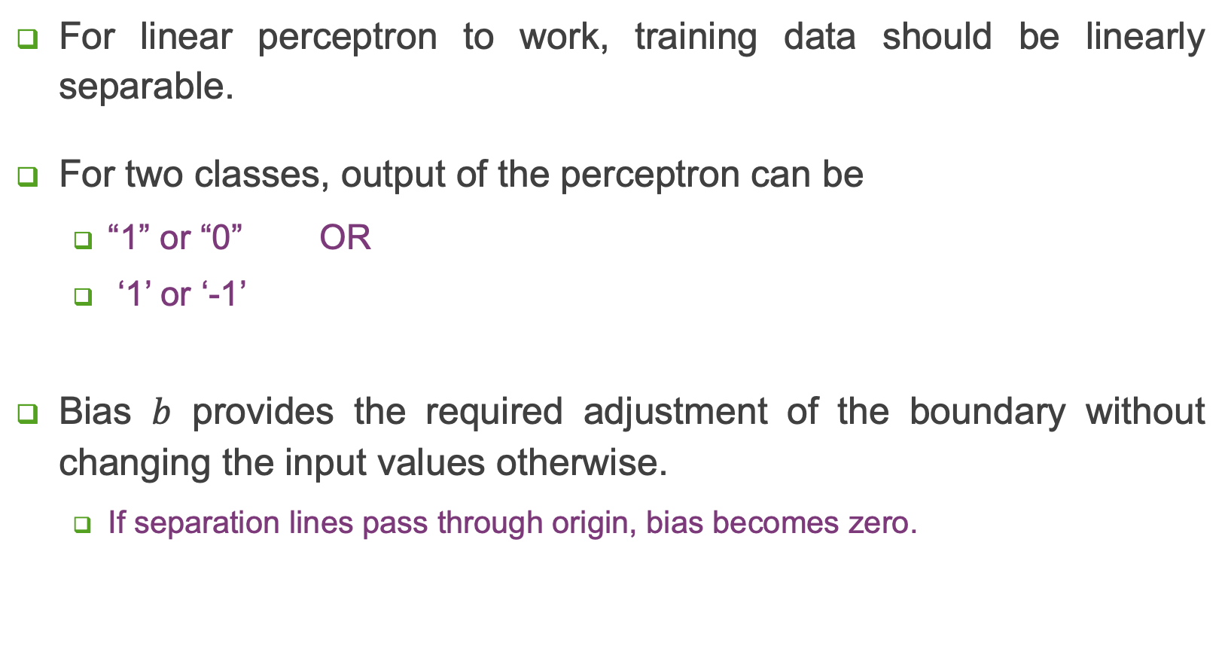
Linear Separability
For linear perceptron to work, training data should be linearly separable.
For two classes, output of the perceptron can be
“1” or “0” OR
‘1’ or ‘-1’
Bias $b$ provides the required adjustment of the boundary without changing the input values otherwise.
If separation lines pass through origin, bias becomes zero.

Slide 13
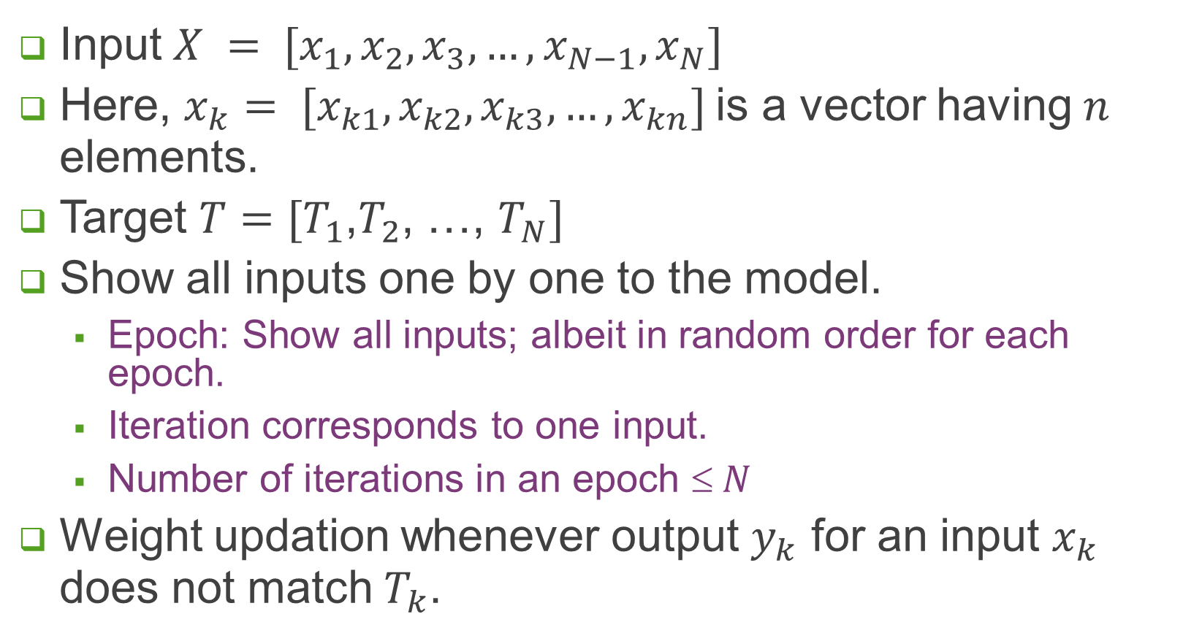
Perceptron Training
Input $X = [x_{1},x_{2},x_{3},…,x_{N−1},x_{N}]$
Here, $x_{k}= [x_{k1},x_{k2},x_{k3},…, x_{kn}]$is a vector having $n$ elements.
Target $T=[T_{1}$,$T_{2}$, …, $T_{N}]$
Show all inputs one by one to the model.
Epoch: Show all inputs; albeit in random order for each epoch.
Iteration corresponds to one input.
Number of iterations in an epoch $ N$
Weight updation whenever output $y_{k}$ for an input $x_{k}$ does not match $T_{k}$.

Slide 14
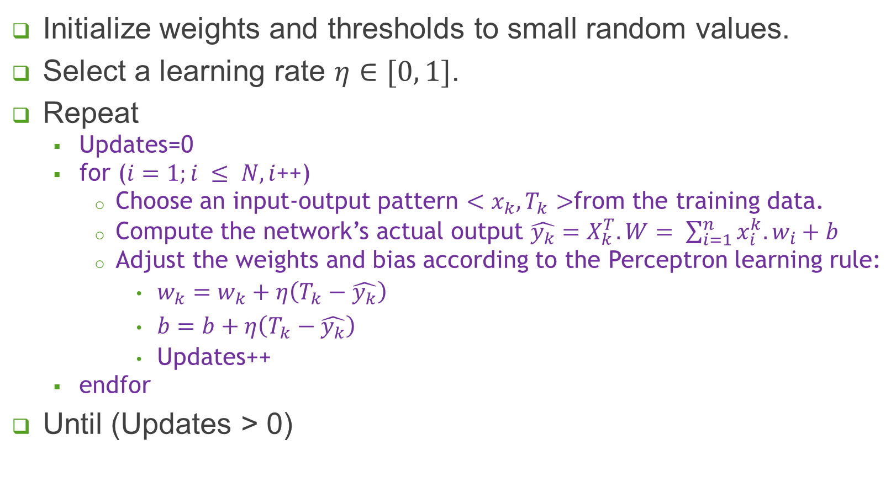
Perceptron Training Algorithm
Initialize weights and thresholds to small random values.
Select a learning rate $η∈[0, 1]$.
Repeat
Updates=0
for ($i=1;i ≤ N, i$++)
Choose an input-output pattern $<x_{k}, T_{k}>$from the training data.
Compute the network’s actual output $\hat{y_{k}}=X_{k}^{T}.W= \sum_{i=1}^{n}{x_{i}^{k}.w_{i}}+b$
Adjust the weights and bias according to the Perceptron learning rule:
$w_{k}=w_{k}+η\left(T_{k}−\hat{y_{k}}\right)$
$b=b+η\left(T_{k}−\hat{y_{k}}\right)$
Updates++
endfor
Until (Updates > 0)

Slide 15
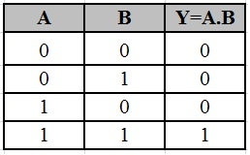

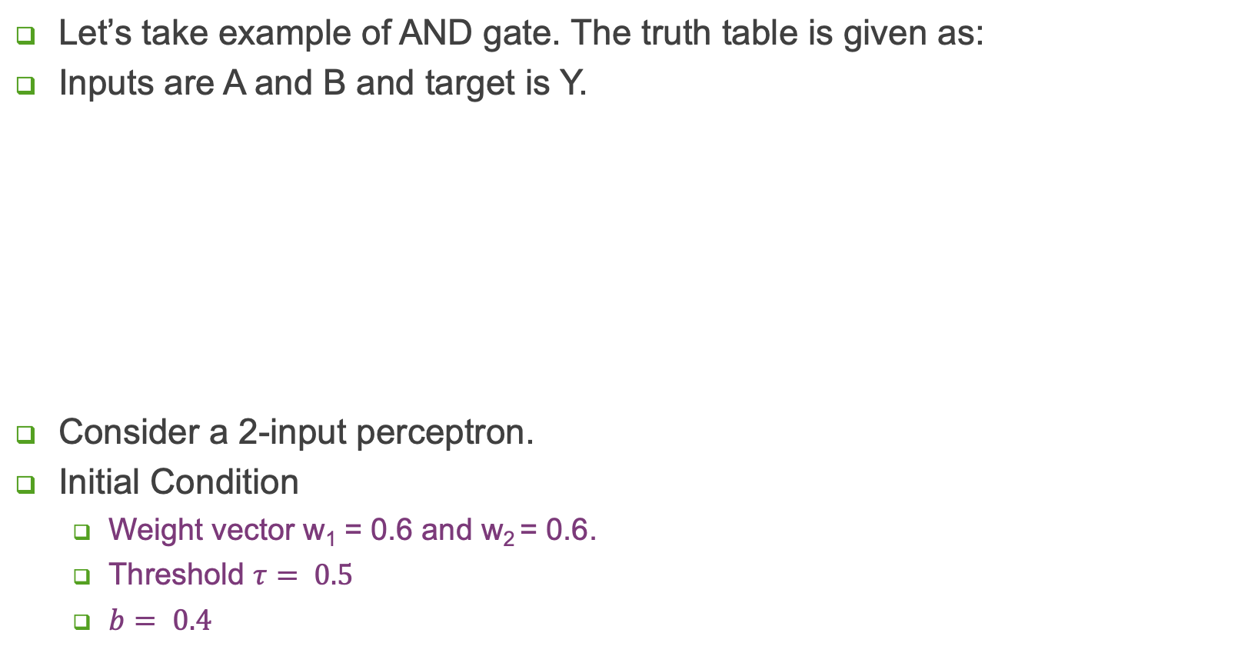



Example – Classification Problem
Let’s take example of AND gate. The truth table is given as:
Inputs are A and B and target is Y.
Consider a 2-input perceptron.
Initial Condition
Weight vector w₁ = 0.6 and w₂ = 0.6.
Threshold $τ= 0.5$
$b= 0.4$
AND logic
$$1$$
$$0$$
$$0$$
$$1$$

Slide 16

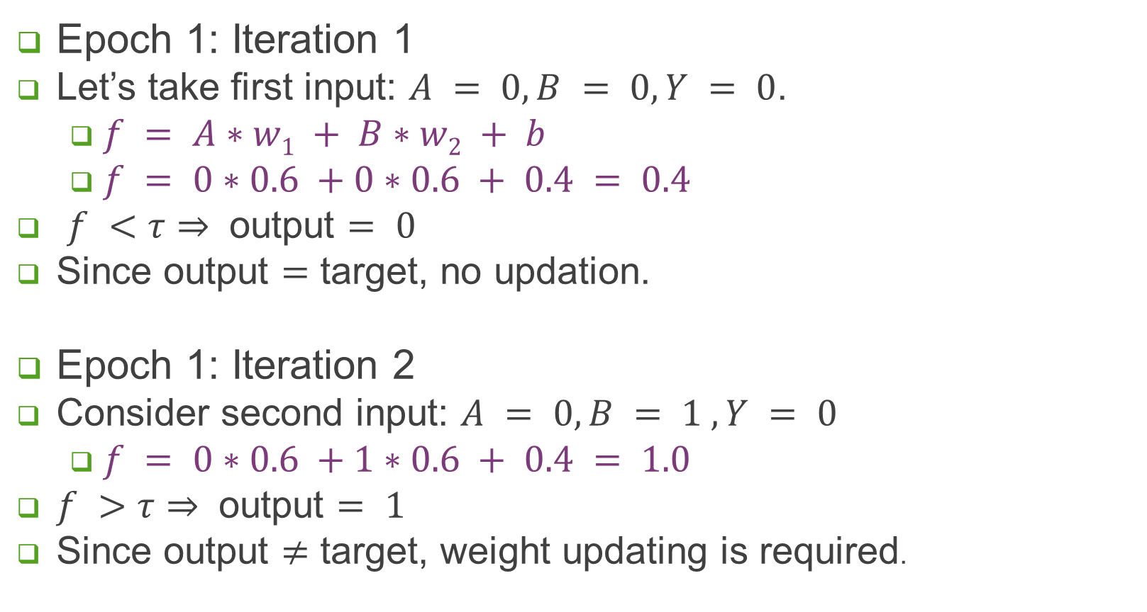
Example – Classification Problem
Epoch 1: Iteration 1
Let’s take first input: $A = 0, B = 0, Y = 0$.
$f = A∗w1 + B∗w2 + b$
$f = 0∗0.6 +0∗0.6 + 0.4 = 0.4$
$f <τ⇒$ output $= 0$
Since output $=$ target, no updation.
Epoch 1: Iteration 2
Consider second input: $A = 0, B = 1 , Y = 0$
$f = 0∗0.6 +1∗0.6 + 0.4 = 1.0$
$f >$ $τ⇒$ output $= 1$
Since output $≠$ target, weight updating is required.
w₁ = 0.6 and w₂ = 0.6.
Threshold $τ= 0.5$
$$b= 0.4$$

Slide 17
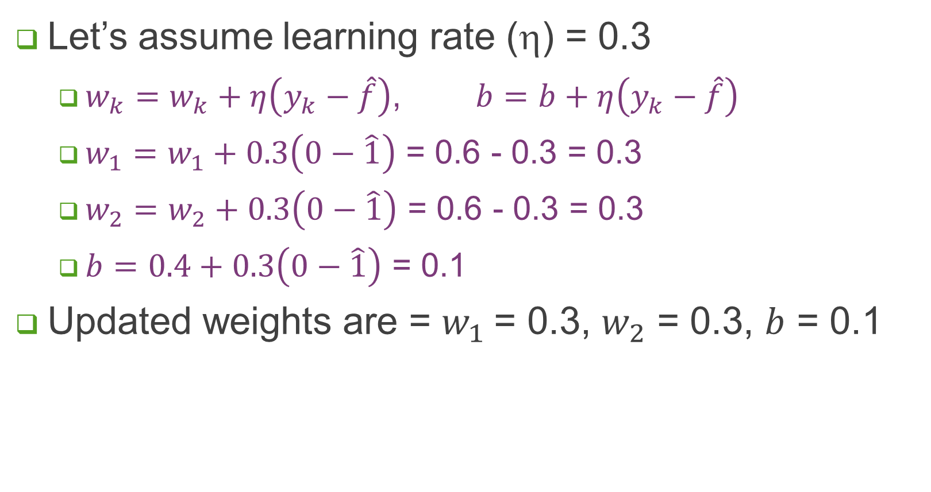
Example – Classification Problem
Let’s assume learning rate (η) = 0.3
$w_{k}=w_{k}+η\left(y_{k}−\hat{f}\right)$, $b=b+η\left(y_{k}−\hat{f}\right)$
$w_{1}=w_{1}+0.3\left(0−\hat{1}\right)$ = 0.6 - 0.3 = 0.3
$w_{2}=w_{2}+0.3\left(0−\hat{1}\right)$ = 0.6 - 0.3 = 0.3
$b=0.4+0.3\left(0−\hat{1}\right)$ = 0.1
Updated weights are = $w_{1}$= 0.3, $w_{2}$ = 0.3, $b$ = 0.1

Slide 18

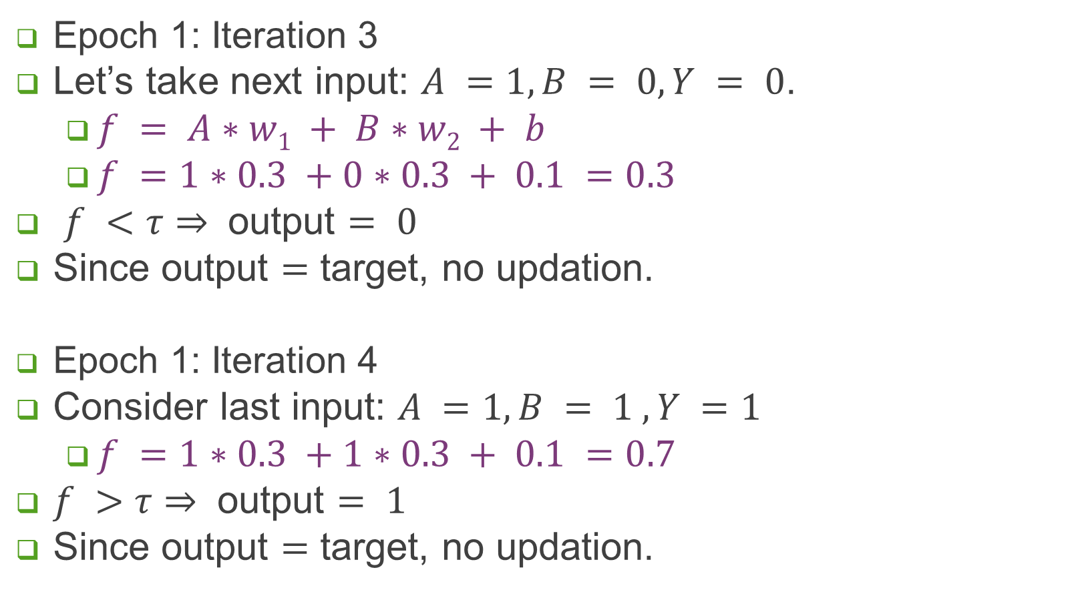
Example – Classification Problem
Epoch 1: Iteration 3
Let’s take next input: $A =1, B = 0, Y = 0$.
$f = A∗w1 + B∗w2 + b$
$f =1∗0.3 +0∗0.3 + 0.1 =0.3$
$f <τ⇒$ output $= 0$
Since output $=$ target, no updation.
Epoch 1: Iteration 4
Consider last input: $A =1, B = 1 , Y =1$
$f =1∗0.3 +1∗0.3 + 0.1 =0.7$
$f >$ $τ⇒$ output $= 1$
Since output $=$ target, no updation.
w₁ = 0.3 and w₂ = 0.3.
Threshold $τ= 0.5$
$$b= 0.1$$

Slide 19
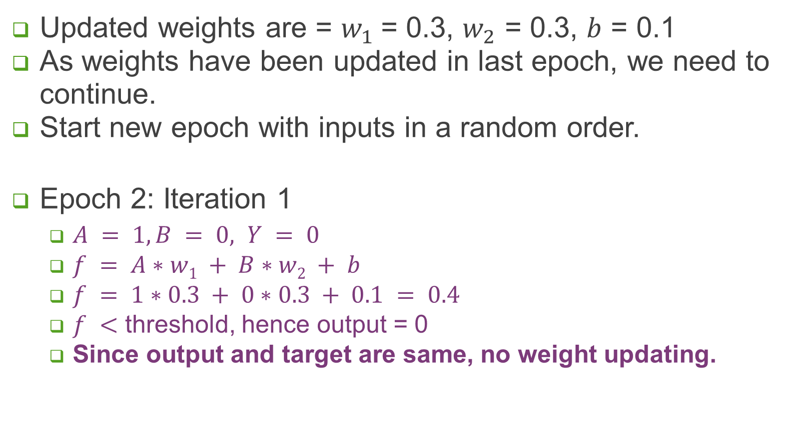
Example – Classification Problem
Updated weights are = $w_{1}$= 0.3, $w_{2}$ = 0.3, $b$ = 0.1
As weights have been updated in last epoch, we need to continue.
Start new epoch with inputs in a random order.
Epoch 2: Iteration 1
$A = 1, B = 0, Y = 0$
$f = A∗w1 + B∗w2 + b$
$f = 1∗0.3 + 0∗0.3 + 0.1 = 0.4$
$f <$ threshold, hence output = 0
Since output and target are same, no weight updating.

Slide 20
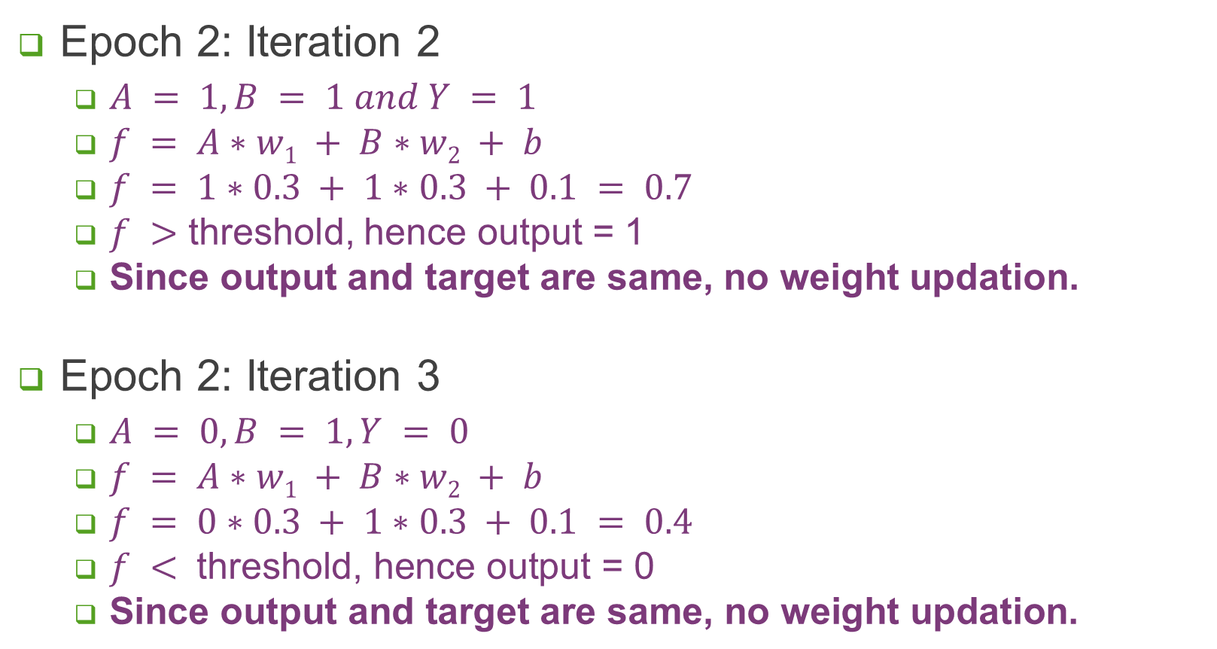
Example – Classification Problem
Epoch 2: Iteration 2
$A = 1, B = 1 and Y = 1$
$f = A∗w1 + B∗w2 + b$
$f = 1∗0.3 + 1∗0.3 + 0.1 = 0.7$
$f >$ threshold, hence output = 1
Since output and target are same, no weight updation.
Epoch 2: Iteration 3
$A = 0, B = 1, Y = 0$
$f = A∗w1 + B∗w2 + b$
$f = 0∗0.3 + 1∗0.3 + 0.1 = 0.4$
$f < \text{threshold}\text{, }\text{hence} \text{output}\text{ = 0}$
$\text{Since} \text{output} \text{and} \text{target} \text{are} \text{same}\text{, }\text{no} \text{weight} \text{updati}\text{on}\text{.}$

Slide 21
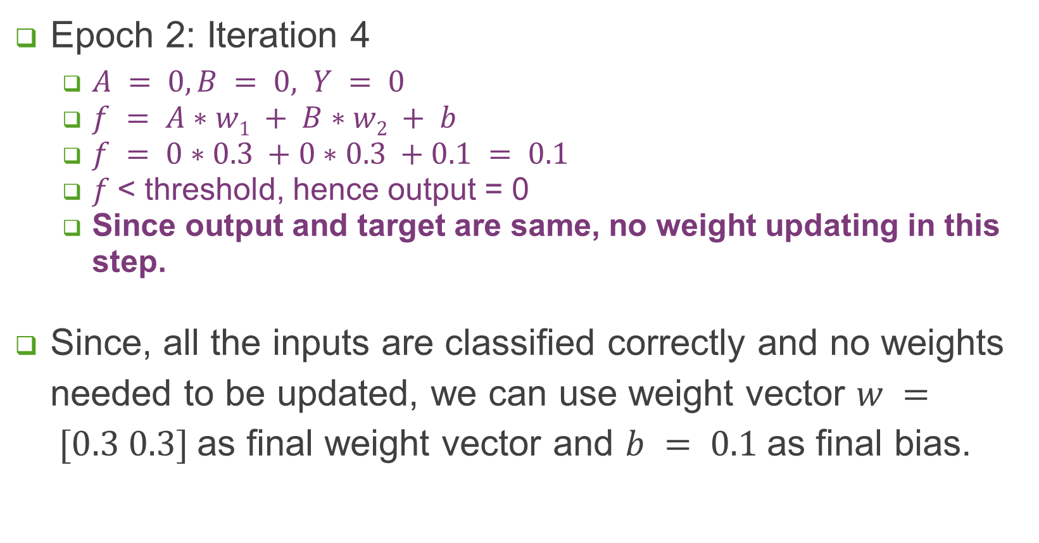
Example – Classification Problem
Epoch 2: Iteration 4
$A = 0, B = 0, Y = 0$
$f = A∗w1 + B∗w2 + b$
$f = 0∗0.3 +0∗0.3 +0.1 = 0.1$
$f$< threshold, hence output = 0
Since output and target are same, no weight updating in this step.
Since, all the inputs are classified correctly and no weights needed to be updated, we can use weight vector $w = [0.3 0.3]$as final weight vector and $b = 0.1$as final bias.

Slide 22
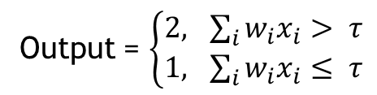

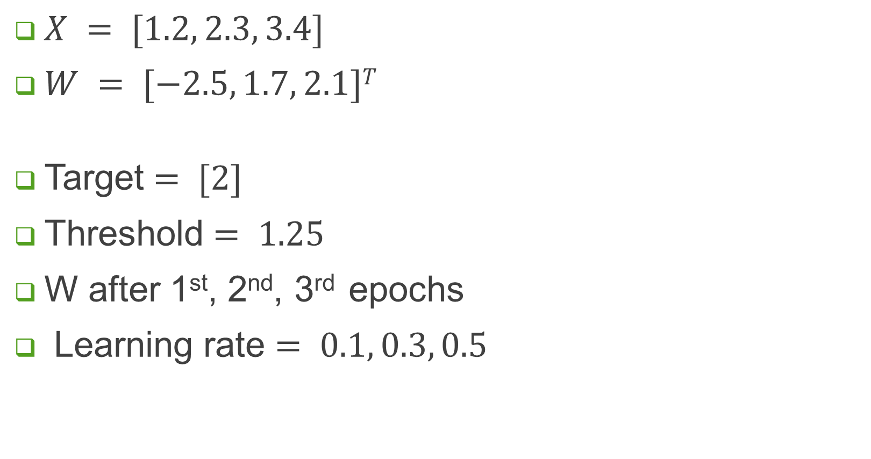


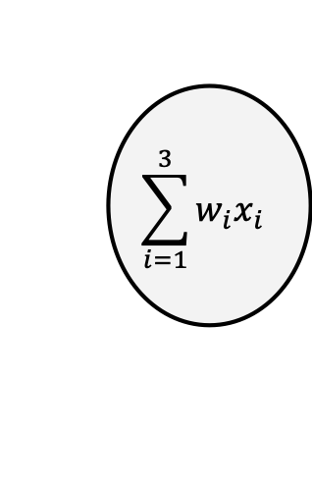
Assignment 1
$X = [1.2, 2.3, 3.4]$
$W = [−2.5, 1.7, 2.1]T$
Target $= [2]$
Threshold $= 1.25$
W after 1st, 2nd, 3rd epochs
Learning rate $= 0.1, 0.3, 0.5$
$$w_{1}$$
$$\sum_{i=1}^{3}{w_{i}x_{i}}$$
$$w_{2}$$
Target = 1
Output = $\left\{\begin{aligned}2, \sum_{i}{w_{i}x_{i}}> τ \\ 1, \sum_{i}{w_{i}x_{i}}≤ τ\end{aligned}\right.$
$$w_{3}$$

Slide 23
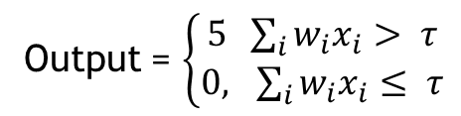
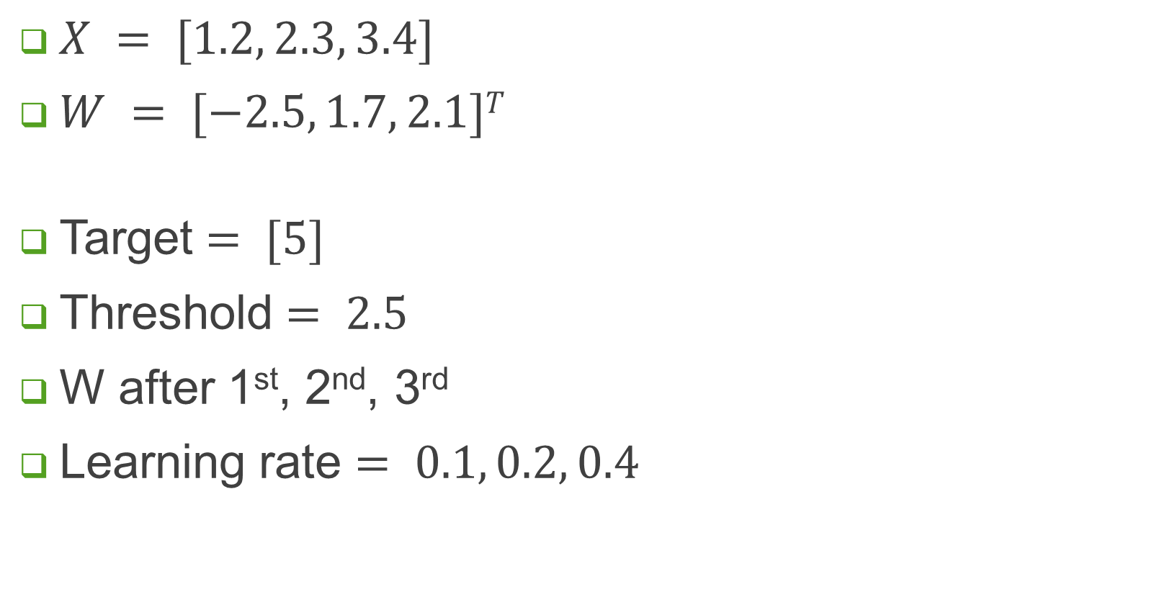
Assignment 2
$X = [1.2, 2.3, 3.4]$
$W = [−2.5, 1.7, 2.1]T$
Target $= [5]$
Threshold $= 2.5$
W after 1st, 2nd, 3rd
Learning rate $= 0.1, 0.2, 0.4$
$$w_{1}$$
$$\sum_{i=1}^{3}{w_{i}x_{i}}$$
$$w_{2}$$
Target = 5
Output = $\left\{\begin{aligned}5 \sum_{i}{w_{i}x_{i}}> τ \\ 0, \sum_{i}{w_{i}x_{i}}≤ τ\end{aligned}\right.$
$$w_{3}$$

Slide 24
Non Linear Separability
2D data, a line can separate two classes.
Decision: points above (below) line - class 1 (2)
classifier will always give errors.
classifier may go into infinite loop or it will make incorrect predictions.
single layer perceptron is inadequate; multi layer perceptron is required.
Linearly Separable Data
Non-Linearly Separable Data

Slide 25
Summary
Linear Perceptron is a mathematical model which is used to classify the binary cases that are linearly separable.
Learning rule: the algorithm will automatically adjust the weights and bias according to the training data.
Single layer perceptron is used for learning the patterns which are linearly separable.
Non linearly separable data,
Linear perceptron is not adequate.
Multi Layer Perceptron (MLP) is needed.
More processing than single layer perceptron.
More time in learning,
Can discriminate more complex patterns.

Slide 26
Multilayer Perceptron (MLP)
Increase number of neurons
Activation function
Increase number of layers

Slide 27
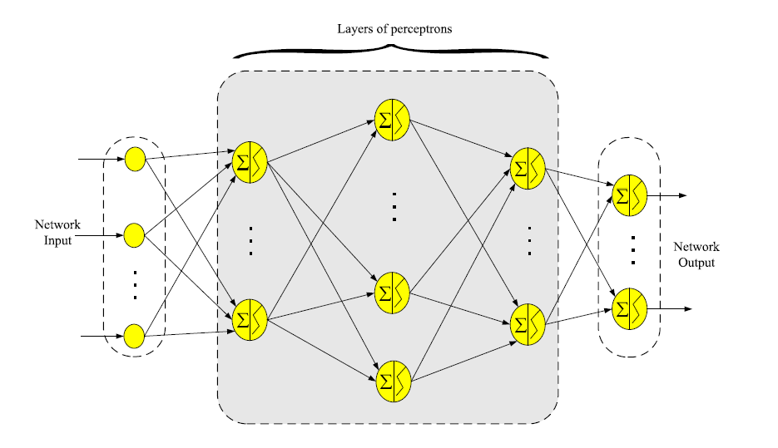
MLP Architecture

Slide 28
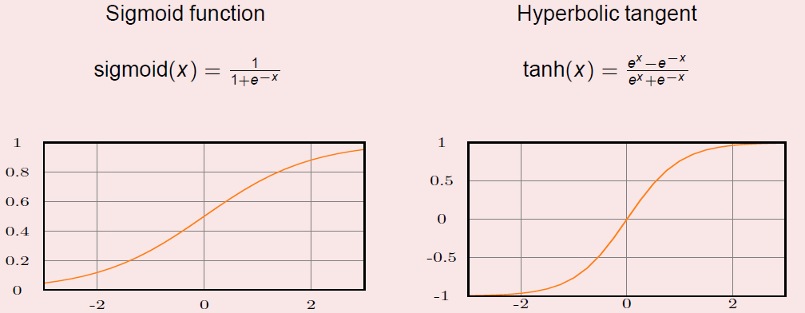
Activation Functions

Slide 29
Backpropagation
Weight-update rule requires an estimate of the error.
Aim is to optimize loss function, a function of error. MSE (mean square error), MAE (mean absolute error)
Backpropagation of error:
Error is known only at output. Need to be propagated in backward direction to calculate the error for each neuron. Only then weight-updation can be applied.
Objective is to reduce the error in training.
Error should not become zero. This implies that trained network has memorize the training data. Being specific to training data, network shall exhibit error for any slight variation in data and is not able to generalize to new unseen input instances
Weight update should nudge the network towards a set of weights that captures the general distribution of the data and not specifics of the training instances.

Slide 30
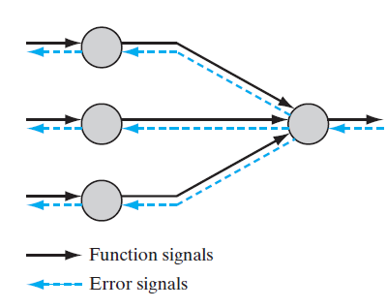
Signal Propagation
Forward Propagation of input (or function) signals:
Input / Function Signals propagate forward (neuron by neuron) through the network, and emerges as an output signal at the last (output) layer. At each neuron, the signal is calculated as a function of the inputs and respective weights.
Back Propagation of Error Signals
An error signal originates at an output neuron of the network and propagates backward (layer by layer) through the network. This involves the computation of an estimate of the gradient vector (i.e., the gradients of the error surface with respect to the weights connected to the inputs of a neuron),

Slide 31
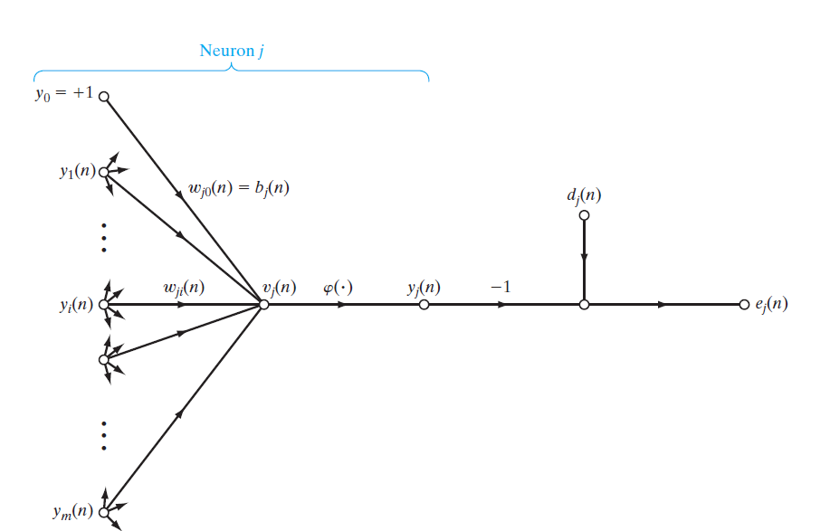

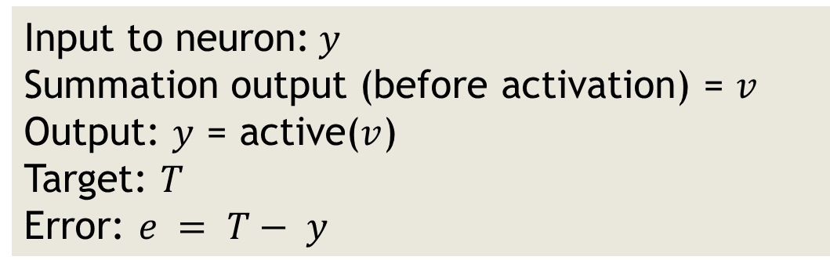
$$T_{j}(n)$$
Input to neuron:$y$
Summation output (before activation) = $v$
Output: $y$ = active($v$)
Target: $T$
Error: $e = T− y$

Slide 32


$$v_{j}=\sum{w_{ji}}y_{i}$$
$$T_{j}(n)$$

Slide 33

$$v_{j}=\sum{w_{ji}}y_{i}$$
$$y_{j}=φ(v_{j})$$
$$T_{j}(n)$$

Slide 34

$$v_{j}=\sum{w_{ji}}y_{i}$$
$$y_{j}=φ(v_{j})$$
$$T_{j}(n)$$
$$e_{j}=T_{j}−y_{j}$$

Slide 35

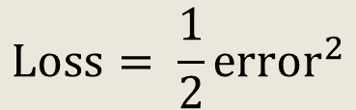
$$v_{j}=\sum{w_{ji}}y_{i}$$
$$y_{j}=φ(v_{j})$$
$$T_{j}(n)$$
$$e_{j}=T_{j}−y_{j}$$
$$\text{Loss}= \frac{1}{2}{\text{error}}^{2}$$

Slide 36
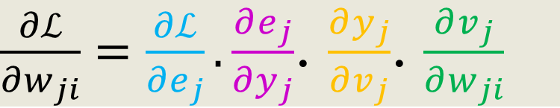
$\frac{∂ℒ}{∂w_{ji}}=\frac{∂ℒ}{∂e_{j}}.\frac{∂e_{j}}{∂y_{j}}$. $\frac{∂y_{j}}{∂v_{j}}$. $\frac{∂v_{j}}{∂w_{ji}}$
$$T_{j}(n)$$

Slide 37
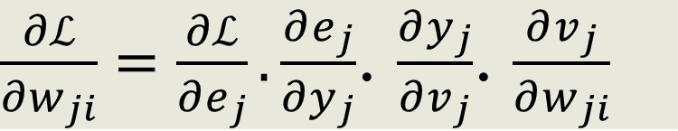
$\frac{∂ℒ}{∂w_{ji}}=\frac{∂ℒ}{∂e_{j}}.\frac{∂e_{j}}{∂y_{j}}$. $\frac{∂y_{j}}{∂v_{j}}$. $\frac{∂v_{j}}{∂w_{ji}}$
$$T_{j}(n)$$

Slide 38
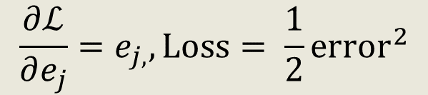
$\frac{∂ℒ}{∂w_{ji}}=\frac{∂ℒ}{∂e_{j}}.\frac{∂e_{j}}{∂y_{j}}$. $\frac{∂y_{j}}{∂v_{j}}$. $\frac{∂v_{j}}{∂w_{ji}}$
$$\frac{∂ℒ}{∂e_{j}}=e_{j, },\text{Loss}= \frac{1}{2}{\text{error}}^{2}$$
$$T_{j}(n)$$

Slide 39
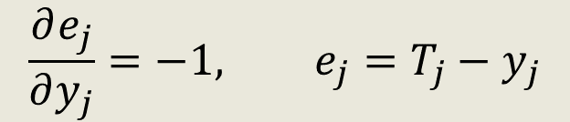
$\frac{∂ℒ}{∂w_{ji}}=\frac{∂ℒ}{∂e_{j}}.\frac{∂e_{j}}{∂y_{j}}$. $\frac{∂y_{j}}{∂v_{j}}$. $\frac{∂v_{j}}{∂w_{ji}}$
$$\frac{∂ℒ}{∂e_{j}}=e_{j, },\text{Loss}= \frac{1}{2}{\text{error}}^{2}$$
$$T_{j}(n)$$
$$\frac{∂e_{j}}{∂y_{j}}=−1, e_{j}=T_{j}−y_{j}$$

Slide 40
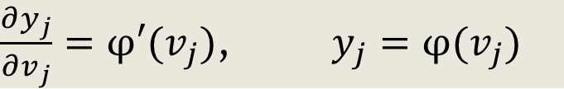
$\frac{∂ℒ}{∂w_{ji}}=\frac{∂ℒ}{∂e_{j}}.\frac{∂e_{j}}{∂y_{j}}$. $\frac{∂y_{j}}{∂v_{j}}$. $\frac{∂v_{j}}{∂w_{ji}}$
$$\frac{∂ℒ}{∂e_{j}}=e_{j, },\text{Loss}= \frac{1}{2}{\text{error}}^{2}$$
$$T_{j}(n)$$
$$\frac{∂e_{j}}{∂y_{j}}=−1, e_{j}=T_{j}−y_{j}$$
$\frac{∂y_{j}}{∂v_{j}}=φ′(v_{j})$, $y_{j}=φ(v_{j})$

Slide 41
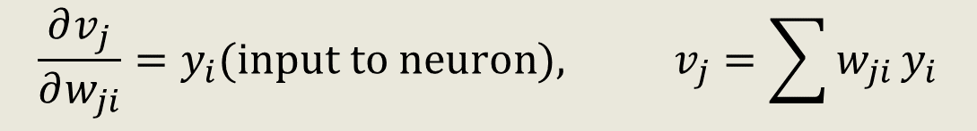
$\frac{∂ℒ}{∂w_{ji}}=\frac{∂ℒ}{∂e_{j}}.\frac{∂e_{j}}{∂y_{j}}$. $\frac{∂y_{j}}{∂v_{j}}$. $\frac{∂v_{j}}{∂w_{ji}}$
$$\frac{∂ℒ}{∂e_{j}}=e_{j, },\text{Loss}= \frac{1}{2}{\text{error}}^{2}$$
$$T_{j}(n)$$
$$\frac{∂e_{j}}{∂y_{j}}=−1, e_{j}=T_{j}−y_{j}$$
$\frac{∂y_{j}}{∂v_{j}}=φ′(v_{j})$, $y_{j}=φ(v_{j})$
$$\frac{∂v_{j}}{∂w_{ji}}=y_{i}(\text{input} \text{to} \text{neuron}\text{),} v_{j}=\sum{w_{ji}}y_{i}$$

Slide 42
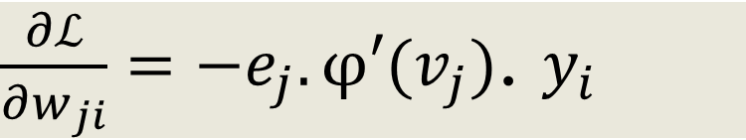
$$T_{j}(n)$$
$\frac{∂ℒ}{∂w_{ji}}=−e_{j}.φ′(v_{j})$. $y_{i}$

Slide 43
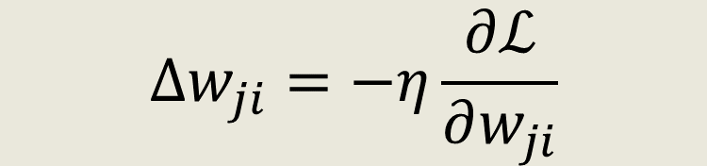
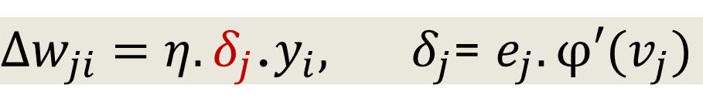



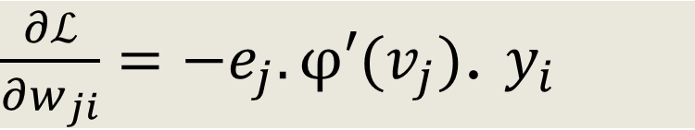
Learning Rule
$$∆w_{ji}=−η\frac{∂ℒ}{∂w_{ji}}$$
Weight updation
$δ_{j}$ is local gradient.
Change in weight $∝$ local gradient and input
Change in weight $∝$ error, derivative of activation, and input
$\frac{∂ℒ}{∂w_{ji}}=−e_{j}.φ′(v_{j})$. $y_{i}$
$∆w_{ji}=η.e_{j}.φ′(v_{j})$.$y_{i}$
$∆w_{ji}=η.e_{j}.φ′(v_{j})$.$y_{i}$
$∆w_{ji}=η. δ_{j}$.$y_{i}, δ_{j}$= $e_{j}.φ′(v_{j})$

Slide 44
Hidden Layer
Derivation in previous slides valid only when
Error is known
Possible only for output layer neurons
Challenge
Hidden layer neurons
Also a hidden layer is connected to many output neurons.

Slide 45
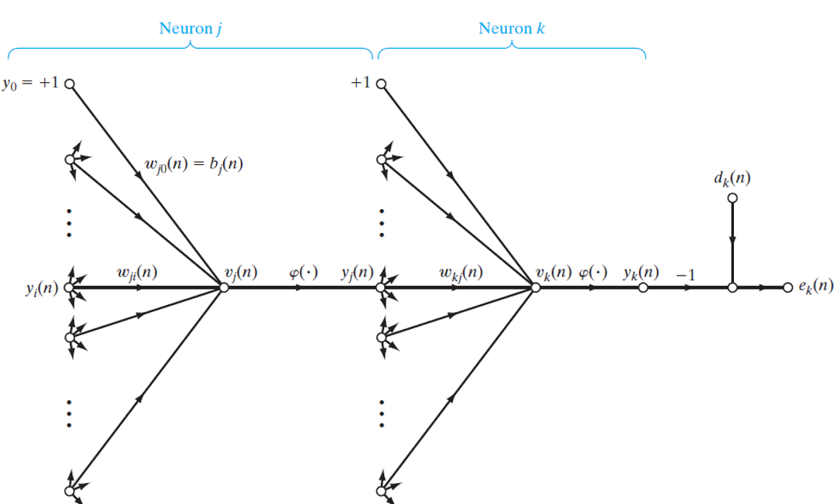

Slide 46

$$\text{Index} k \text{is} \text{output} \text{node} \text{and} \text{Index} j \text{refers} \text{to} \text{hidden} \text{node}\text{.}$$
Local gradient ${ δ}_{k}$at output layer is defined as follows:
$δ_{k}$= $e_{k}.φ^{′}\left(v_{k}\right), k$ is output node.

Slide 47

$$\text{Index} k \text{is} \text{output} \text{node} \text{and} \text{Index} j \text{refers} \text{to} \text{hidden} \text{node}\text{.}$$
Local gradient ${ δ}_{k}$at output layer is defined as follows:
$δ_{k}$= $e_{k}.φ^{′}\left(v_{k}\right), k$ is output node.
$$ℒ \text{=} \frac{1}{2}\sum_{k=C}{e_{k}^{2}}, \text{neuron} k \text{is} \text{output} \text{node}\text{.}$$

Slide 48


$$\text{Index} k \text{is} \text{output} \text{node} \text{and} \text{Index} j \text{refers} \text{to} \text{hidden} \text{node}\text{.}$$
Local gradient ${ δ}_{k}$at output layer is defined as follows:
$δ_{k}$= $e_{k}.φ^{′}\left(v_{k}\right), k$ is output node.
$$ℒ \text{=} \frac{1}{2}\sum_{k=C}{e_{k}^{2}}, \text{neuron} k \text{is} \text{output} \text{node}\text{.}$$
$$\frac{∂ℒ}{∂y_{j}}=\sum_{k}{e_{k}}\frac{∂e_{k}}{∂y_{j}}$$
$$\frac{∂ℒ}{∂y_{j}}=\sum_{k}{e_{k}}\frac{∂e_{k}}{∂v_{k}}.\frac{∂v_{k}}{∂y_{j}}$$

Slide 49


$$\text{Index} k \text{is} \text{output} \text{node} \text{and} \text{Index} j \text{refers} \text{to} \text{hidden} \text{node}\text{.}$$
Local gradient ${ δ}_{k}$at output layer is defined as follows:
$δ_{k}$= $e_{k}.φ^{′}\left(v_{k}\right), k$ is output node.
$$ℒ \text{=} \frac{1}{2}\sum_{k=C}{e_{k}^{2}}, \text{neuron} k \text{is} \text{output} \text{node}\text{.}$$
$$\frac{∂ℒ}{∂y_{j}}=\sum_{k}{e_{k}}\frac{∂e_{k}}{∂y_{j}}$$
$$\frac{∂ℒ}{∂y_{j}}=\sum_{k}{e_{k}}\frac{∂e_{k}}{∂v_{k}}.\frac{∂v_{k}}{∂y_{j}}$$
$$e_{k}=T_{k}−y_{k}=T_{k}−φ_{k}(v_{k})$$
$$\frac{∂e_{k}}{∂v_{k}}=−φ_{k}^{′}(v_{k})$$

Slide 50


$$\text{Index} k \text{is} \text{output} \text{node} \text{and} \text{Index} j \text{refers} \text{to} \text{hidden} \text{node}\text{.}$$
Local gradient ${ δ}_{k}$at output layer is defined as follows:
$δ_{k}$= $e_{k}.φ^{′}\left(v_{k}\right), k$ is output node.
$$ℒ \text{=} \frac{1}{2}\sum_{k=C}{e_{k}^{2}}, \text{neuron} k \text{is} \text{output} \text{node}\text{.}$$
$$\frac{∂ℒ}{∂y_{j}}=\sum_{k}{e_{k}}\frac{∂e_{k}}{∂y_{j}}$$
$$\frac{∂ℒ}{∂y_{j}}=\sum_{k}{e_{k}}\frac{∂e_{k}}{∂v_{k}}.\frac{∂v_{k}}{∂y_{j}}$$
$$e_{k}=T_{k}−y_{k}=T_{k}−φ_{k}(v_{k})$$
$$\frac{∂e_{k}}{∂v_{k}}=−φ_{k}^{′}(v_{k})$$
$$v_{k}=\sum_{j=0}^{m}{w_{kj}{.y}_{j}}$$
$$\frac{∂v_{k}}{∂y_{j}}=w_{kj}$$

Slide 51

$$\text{Index} k \text{is} \text{output} \text{node} \text{and} \text{Index} j \text{refers} \text{to} \text{hidden} \text{node}\text{.}$$
Local gradient ${ δ}_{k}$at output layer is defined as follows:
$δ_{k}$= $e_{k}.φ^{′}\left(v_{k}\right), k$ is output node.
$$ℒ \text{=} \frac{1}{2}\sum_{k=C}{e_{k}^{2}}, \text{neuron} k \text{is} \text{output} \text{node}\text{.}$$
$$\frac{∂ℒ}{∂y_{j}}=−\sum_{k}{e_{k}}.φ_{k}^{′}(v_{k}){.w}_{kj}$$
$$\frac{∂ℒ}{∂y_{j}}=\sum_{k}{e_{k}}\frac{∂e_{k}}{∂y_{j}}$$
$$\frac{∂ℒ}{∂y_{j}}=\sum_{k}{e_{k}}\frac{∂e_{k}}{∂v_{k}}.\frac{∂v_{k}}{∂y_{j}}$$
$$e_{k}=T_{k}−y_{k}=T_{k}−φ_{k}(v_{k})$$
$$\frac{∂e_{k}}{∂v_{k}}=−φ_{k}^{′}(v_{k})$$
$$v_{k}=\sum_{j=0}^{m}{w_{kj}{.y}_{j}}$$
$$\frac{∂v_{k}}{∂y_{j}}=w_{kj}$$

Slide 52

$$\text{Index} k \text{is} \text{output} \text{node} \text{and} \text{Index} j \text{refers} \text{to} \text{hidden} \text{node}\text{.}$$
Local gradient ${ δ}_{k}$at output layer is defined as follows:
$δ_{k}$= $e_{k}.φ^{′}\left(v_{k}\right), k$ is output node.
$$ℒ \text{=} \frac{1}{2}\sum_{k=C}{e_{k}^{2}}, \text{neuron} k \text{is} \text{output} \text{node}\text{.}$$
$$\frac{∂ℒ}{∂y_{j}}=−\sum_{k}{e_{k}}.φ_{k}^{′}(v_{k}){.w}_{kj}$$
$$\frac{∂ℒ}{∂y_{j}}=\sum_{k}{e_{k}}\frac{∂e_{k}}{∂y_{j}}$$
$$\frac{∂ℒ}{∂y_{j}}=−\sum_{k}{{δ_{k}.w}_{kj}}$$
$$\frac{∂ℒ}{∂y_{j}}=\sum_{k}{e_{k}}\frac{∂e_{k}}{∂v_{k}}.\frac{∂v_{k}}{∂y_{j}}$$
$$e_{k}=T_{k}−y_{k}=T_{k}−φ_{k}(v_{k})$$
$$\frac{∂e_{k}}{∂v_{k}}=−φ_{k}^{′}(v_{k})$$
$$v_{k}=\sum_{j=0}^{m}{w_{kj}{.y}_{j}}$$
$$\frac{∂v_{k}}{∂y_{j}}=w_{kj}$$

Slide 53

$$\text{Index} k \text{is} \text{output} \text{node} \text{and} \text{Index} j \text{refers} \text{to} \text{hidden} \text{node}\text{.}$$
Local gradient ${ δ}_{k}$at output layer is defined as follows:
$δ_{k}$= $e_{k}.φ^{′}\left(v_{k}\right), k$ is output node.
$$ℒ \text{=} \frac{1}{2}\sum_{k=C}{e_{k}^{2}}, \text{neuron} k \text{is} \text{output} \text{node}\text{.}$$
$$\frac{∂ℒ}{∂y_{j}}=−\sum_{k}{e_{k}}.φ_{k}^{′}(v_{k}){.w}_{kj}$$
$$\frac{∂ℒ}{∂y_{j}}=\sum_{k}{e_{k}}\frac{∂e_{k}}{∂y_{j}}$$
$$\frac{∂ℒ}{∂y_{j}}=−\sum_{k}{{δ_{k}.w}_{kj}}$$
$$\frac{∂ℒ}{∂y_{j}}=\sum_{k}{e_{k}}\frac{∂e_{k}}{∂v_{k}}.\frac{∂v_{k}}{∂y_{j}}$$
$$\text{Redefine} \text{local} \text{gradient}{ δ}_{j} \text{at} \text{hidden} \text{layer}\text{ (}\text{index} j\text{)}$$
$$e_{k}=T_{k}−y_{k}=T_{k}−φ_{k}(v_{k})$$
$$δ_{j}=−\frac{∂ℒ}{∂y_{j}}.\frac{∂y_{j}}{∂v_{j}}=−\frac{∂ℒ}{∂y_{j}}.φ′(v_{j})$$
$$\frac{∂e_{k}}{∂v_{k}}=−φ_{k}^{′}(v_{k})$$
$$v_{k}=\sum_{j=0}^{m}{w_{kj}{.y}_{j}}$$
$$\frac{∂v_{k}}{∂y_{j}}=w_{kj}$$

Slide 54

$$\text{Index} k \text{is} \text{output} \text{node} \text{and} \text{Index} j \text{refers} \text{to} \text{hidden} \text{node}\text{.}$$
Local gradient ${ δ}_{k}$at output layer is defined as follows:
$δ_{k}$= $e_{k}.φ^{′}\left(v_{k}\right), k$ is output node.
$$ℒ \text{=} \frac{1}{2}\sum_{k=C}{e_{k}^{2}}, \text{neuron} k \text{is} \text{output} \text{node}\text{.}$$
$$\frac{∂ℒ}{∂y_{j}}=−\sum_{k}{e_{k}}.φ_{k}^{′}(v_{k}){.w}_{kj}$$
$$\frac{∂ℒ}{∂y_{j}}=\sum_{k}{e_{k}}\frac{∂e_{k}}{∂y_{j}}$$
$$\frac{∂ℒ}{∂y_{j}}=−\sum_{k}{{δ_{k}.w}_{kj}}$$
$$\frac{∂ℒ}{∂y_{j}}=\sum_{k}{e_{k}}\frac{∂e_{k}}{∂v_{k}}.\frac{∂v_{k}}{∂y_{j}}$$
$$\text{Redefine} \text{local} \text{gradient}{ δ}_{j} \text{at} \text{hidden} \text{layer}\text{ (}\text{index} j\text{)}$$
$$e_{k}=T_{k}−y_{k}=T_{k}−φ_{k}(v_{k})$$
$$δ_{j}=−\frac{∂ℒ}{∂y_{j}}.\frac{∂y_{j}}{∂v_{j}}=−\frac{∂ℒ}{∂y_{j}}.φ′(v_{j})$$
$$\frac{∂e_{k}}{∂v_{k}}=−φ_{k}^{′}(v_{k})$$
$$δ_{j}=φ_{j}^{′}(v_{j})\sum_{k}{δ_{k}}{.w}_{kj}$$
$$v_{k}=\sum_{j=0}^{m}{w_{kj}{.y}_{j}}$$
$$\frac{∂v_{k}}{∂y_{j}}=w_{kj}$$

Slide 55


Gradient Computation
$$δ_{j}=φ_{j}^{′}(v_{j})\sum_{k}{δ_{k}}{.w}_{kj}$$
Hidden Layer Neuron
Output Layer Neuron

Slide 56



Weight Updation
If neuron $k$ is an output node, $δ_{k}$= $e_{k}.φ^{′}\left(v_{k}\right)$ i.e. product of the error signal $δ_{k}$= $e_{k}.φ^{′}\left(v_{k}\right)$ and derivative of activation $δ_{k}$= $e_{k}.φ^{′}\left(v_{k}\right)$. Both of these are associated with neuron $k$;
If neuron $j$ is a hidden node, $δ_{j}=φ_{j}^{′}(v_{j})\sum_{k}{δ_{k}}{.w}_{kj}$ i.e. equals the product of the associated derivative $φ_{j}^{′}(v_{j})$ and the weighted sum of the $δ$s computed for the neurons (in the next hidden/output layer in the forward direction) that are connected to neuron $j.$
$∆w_{ji}=$ $η. δ_{j}$.$y_{i},$

Slide 57



$$\text{Index} k \text{is} \text{output} \text{node} \text{and} \text{Index} j \text{refers} \text{to} \text{hidden} \text{node}\text{.}$$
Local gradient ${ δ}_{k}$at output layer is defined as follows:
$δ_{k}$= $e_{k}.φ^{′}\left(v_{k}\right), k$ is output node.
$$ℒ \text{=} \frac{1}{2}\sum_{k=C}{e_{k}^{2}}, \text{neuron} k \text{is} \text{output} \text{node}\text{.}$$
$$\frac{∂ℒ}{∂y_{j}}=−\sum_{k}{e_{k}}.φ_{k}^{′}(v_{k}){.w}_{kj}$$
$$\frac{∂ℒ}{∂y_{j}}=\sum_{k}{e_{k}}\frac{∂e_{k}}{∂y_{j}}$$
$$\frac{∂ℒ}{∂y_{j}}=−\sum_{k}{{δ_{k}.w}_{kj}}$$
$$\frac{∂ℒ}{∂y_{j}}=\sum_{k}{e_{k}}\frac{∂e_{k}}{∂v_{k}}.\frac{∂v_{k}}{∂y_{j}}$$
$$\text{Redefine} \text{local} \text{gradient}{ δ}_{j} \text{at} \text{hidden} \text{layer}\text{ (}\text{index} j\text{)}$$
$$δ_{j}=−\frac{∂ℒ}{∂y_{j}}.\frac{∂y_{j}}{∂v_{j}}=−\frac{∂ℒ}{∂y_{j}}.φ′(v_{j})$$
$$e_{k}=T_{k}−y_{k}=T_{k}−φ_{k}(v_{k})$$
$$\frac{∂e_{k}}{∂v_{k}}=−φ_{k}^{′}(v_{k})$$
$$δ_{j}=φ_{j}^{′}(v_{j})\sum_{k}{δ_{k}}{.w}_{kj}$$
$$v_{k}=\sum_{j=0}^{m}{w_{kj}{.y}_{j}}$$
$∆w_{ji}=−η\frac{∂ℒ}{∂w_{ji}} = η. δ_{j}$.$y_{i},$
$δ_{j}$= $e_{j}.φ^{′}\left(v_{j}\right)$, output layer
$δ_{j}=φ_{j}^{′}(v_{j})\sum_{k}{δ_{k}}{.w}_{kj}$, otherwise
$$\frac{∂v_{k}}{∂y_{j}}=w_{kj}$$

Slide 58
Learning is dependent on derivatives
Derivatives should not approach zero or very small values (vanishing gradient problem)
Point of operation should not be in saturation region.
Large inputs can drive network to saturation or near saturation.
Another problem could be local minima (gradients are zero)
Need perturbation to move away from local minima

Slide 59
Vanishing Gradient Problem
Decrease in error estimates is known as vanishing gradient problem
The gradient over the error surface disappears (tends to zero) as the algorithm works back through the network

Slide 60
Thank you.

